Slide 2
FraimSync 1
Not saved in input; 0 (black pixel) at Output
tdata
Dpl
Dl
D0
D1
D2
D3
D4
Saved in input; pixel at Output
tvalid
tuser
FraimSync 1
Save Data 1
tlast
FraimSync
FraimSync 0
Save Data 0
Add_odd
Not Saved
Saved
FraimSync 0
FraimSync 1
Save Data 1
tdata
Dpl
Dl
D0
D1
D2
D3
D4
tvalid
tuser
tlast
FraimSync
Add_odd
Saved
Not Saved

Slide 3
Not saved in input; 0 (black pixel) at Output
Saved in input; pixel at Output
FraimSync 1
Save Data 1
FraimSync 0
Save Data 0
FraimSync 1
Save Data 1

Slide 4
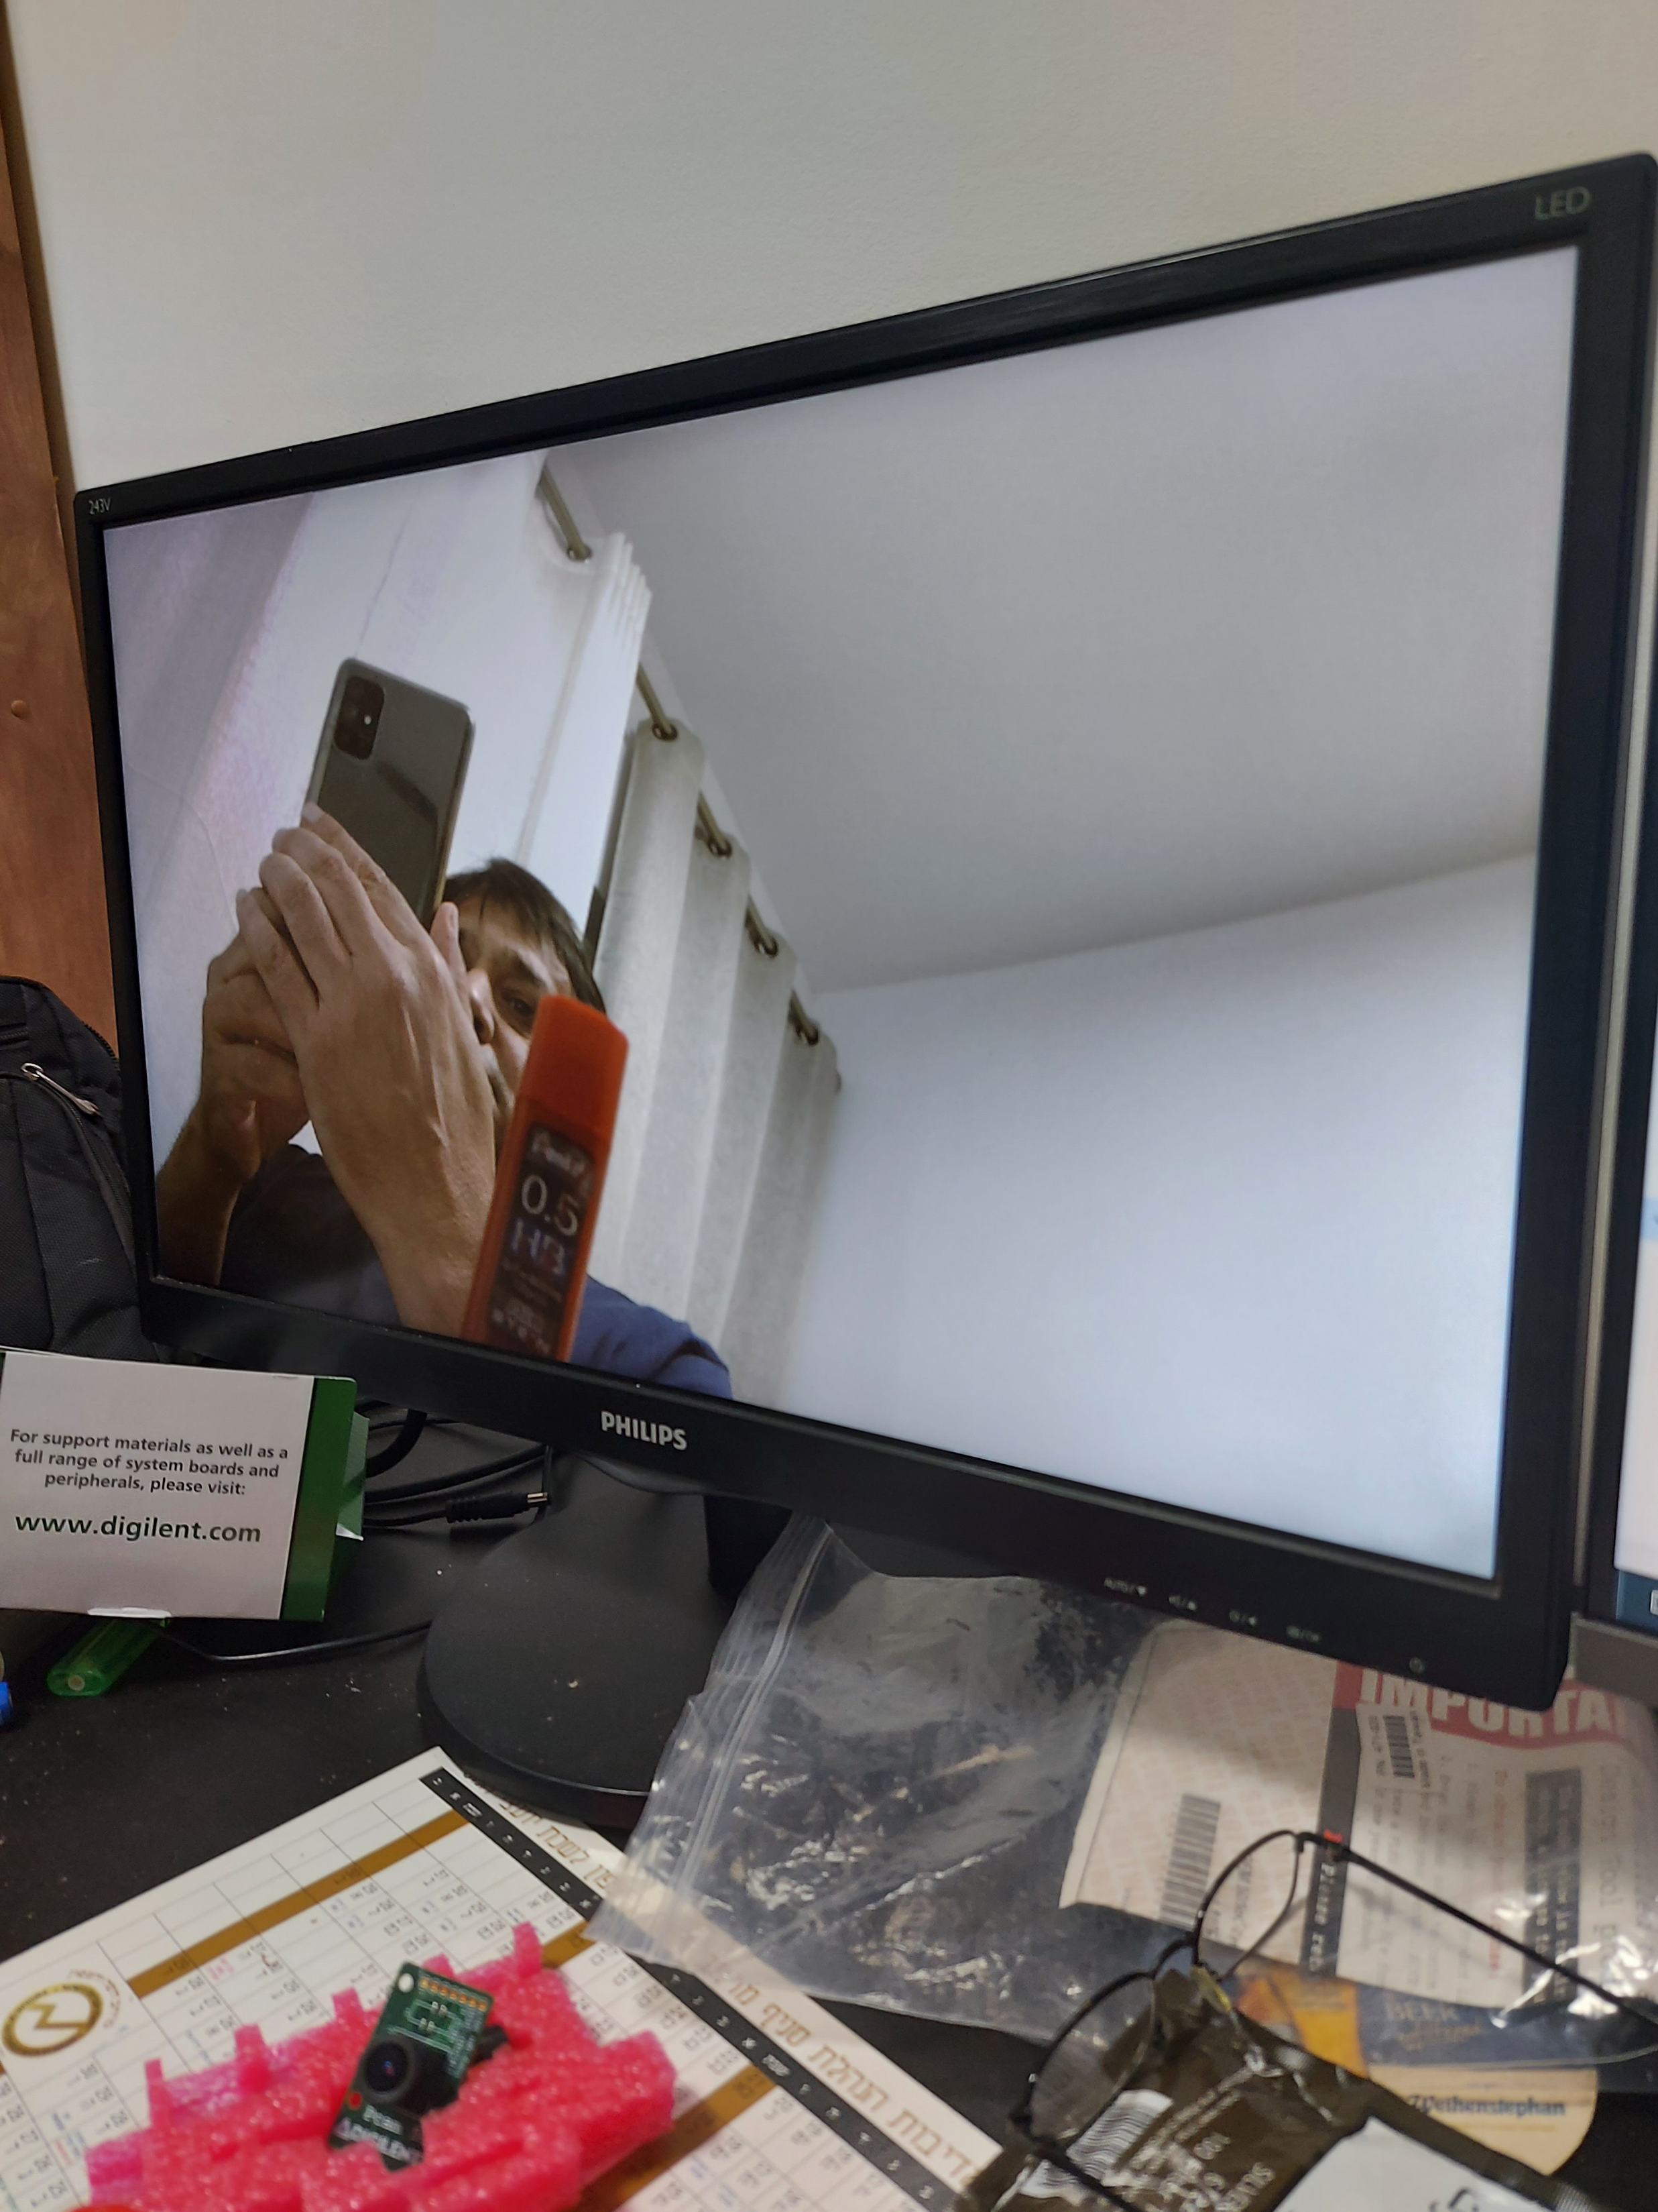
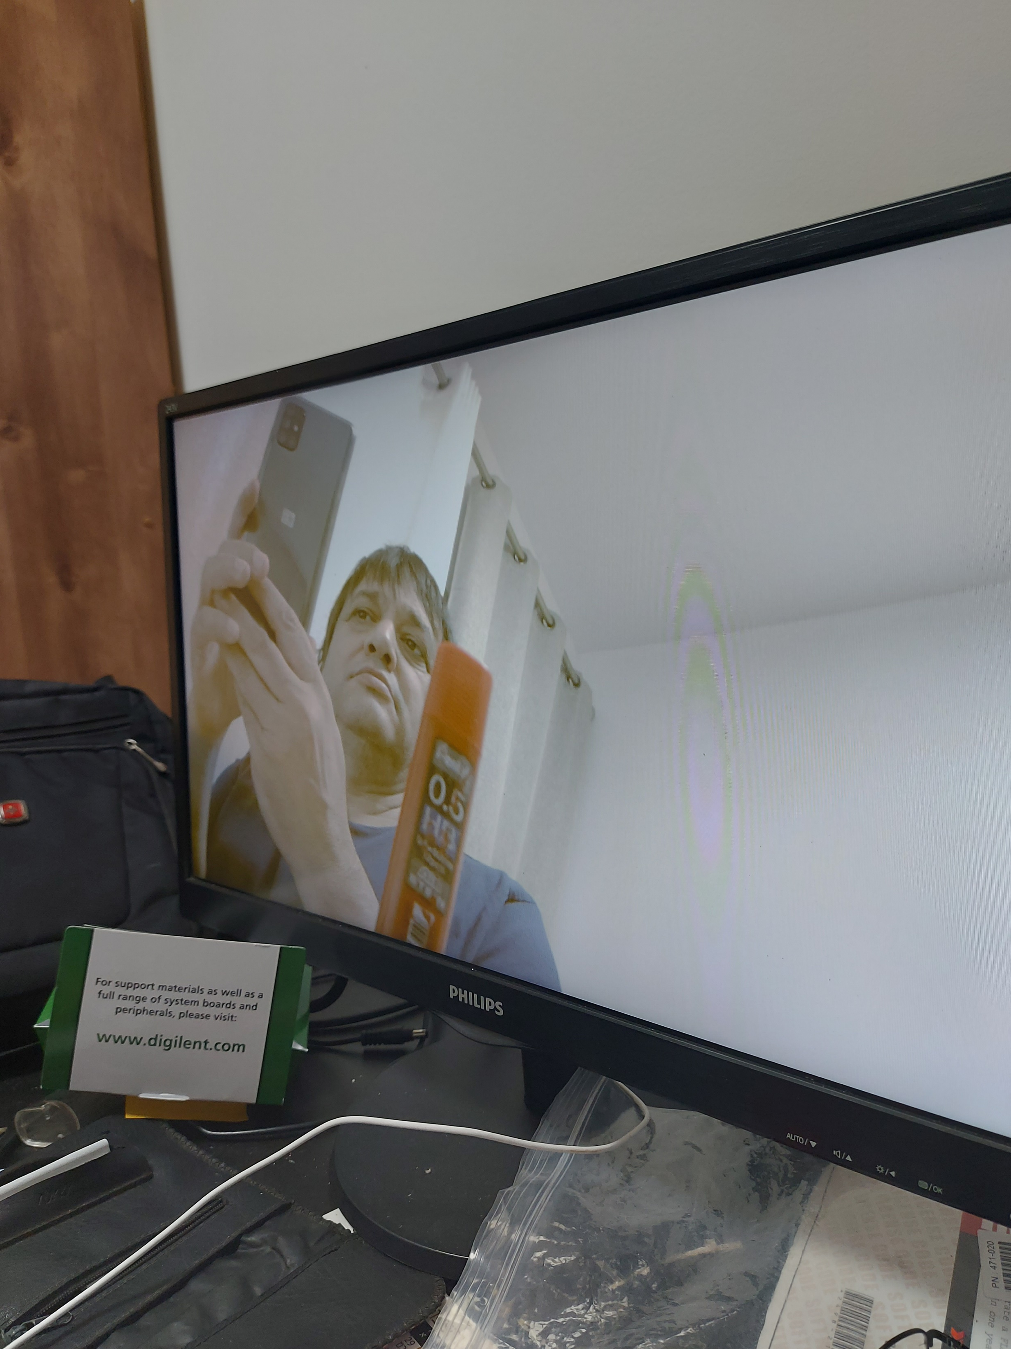

Slide 5
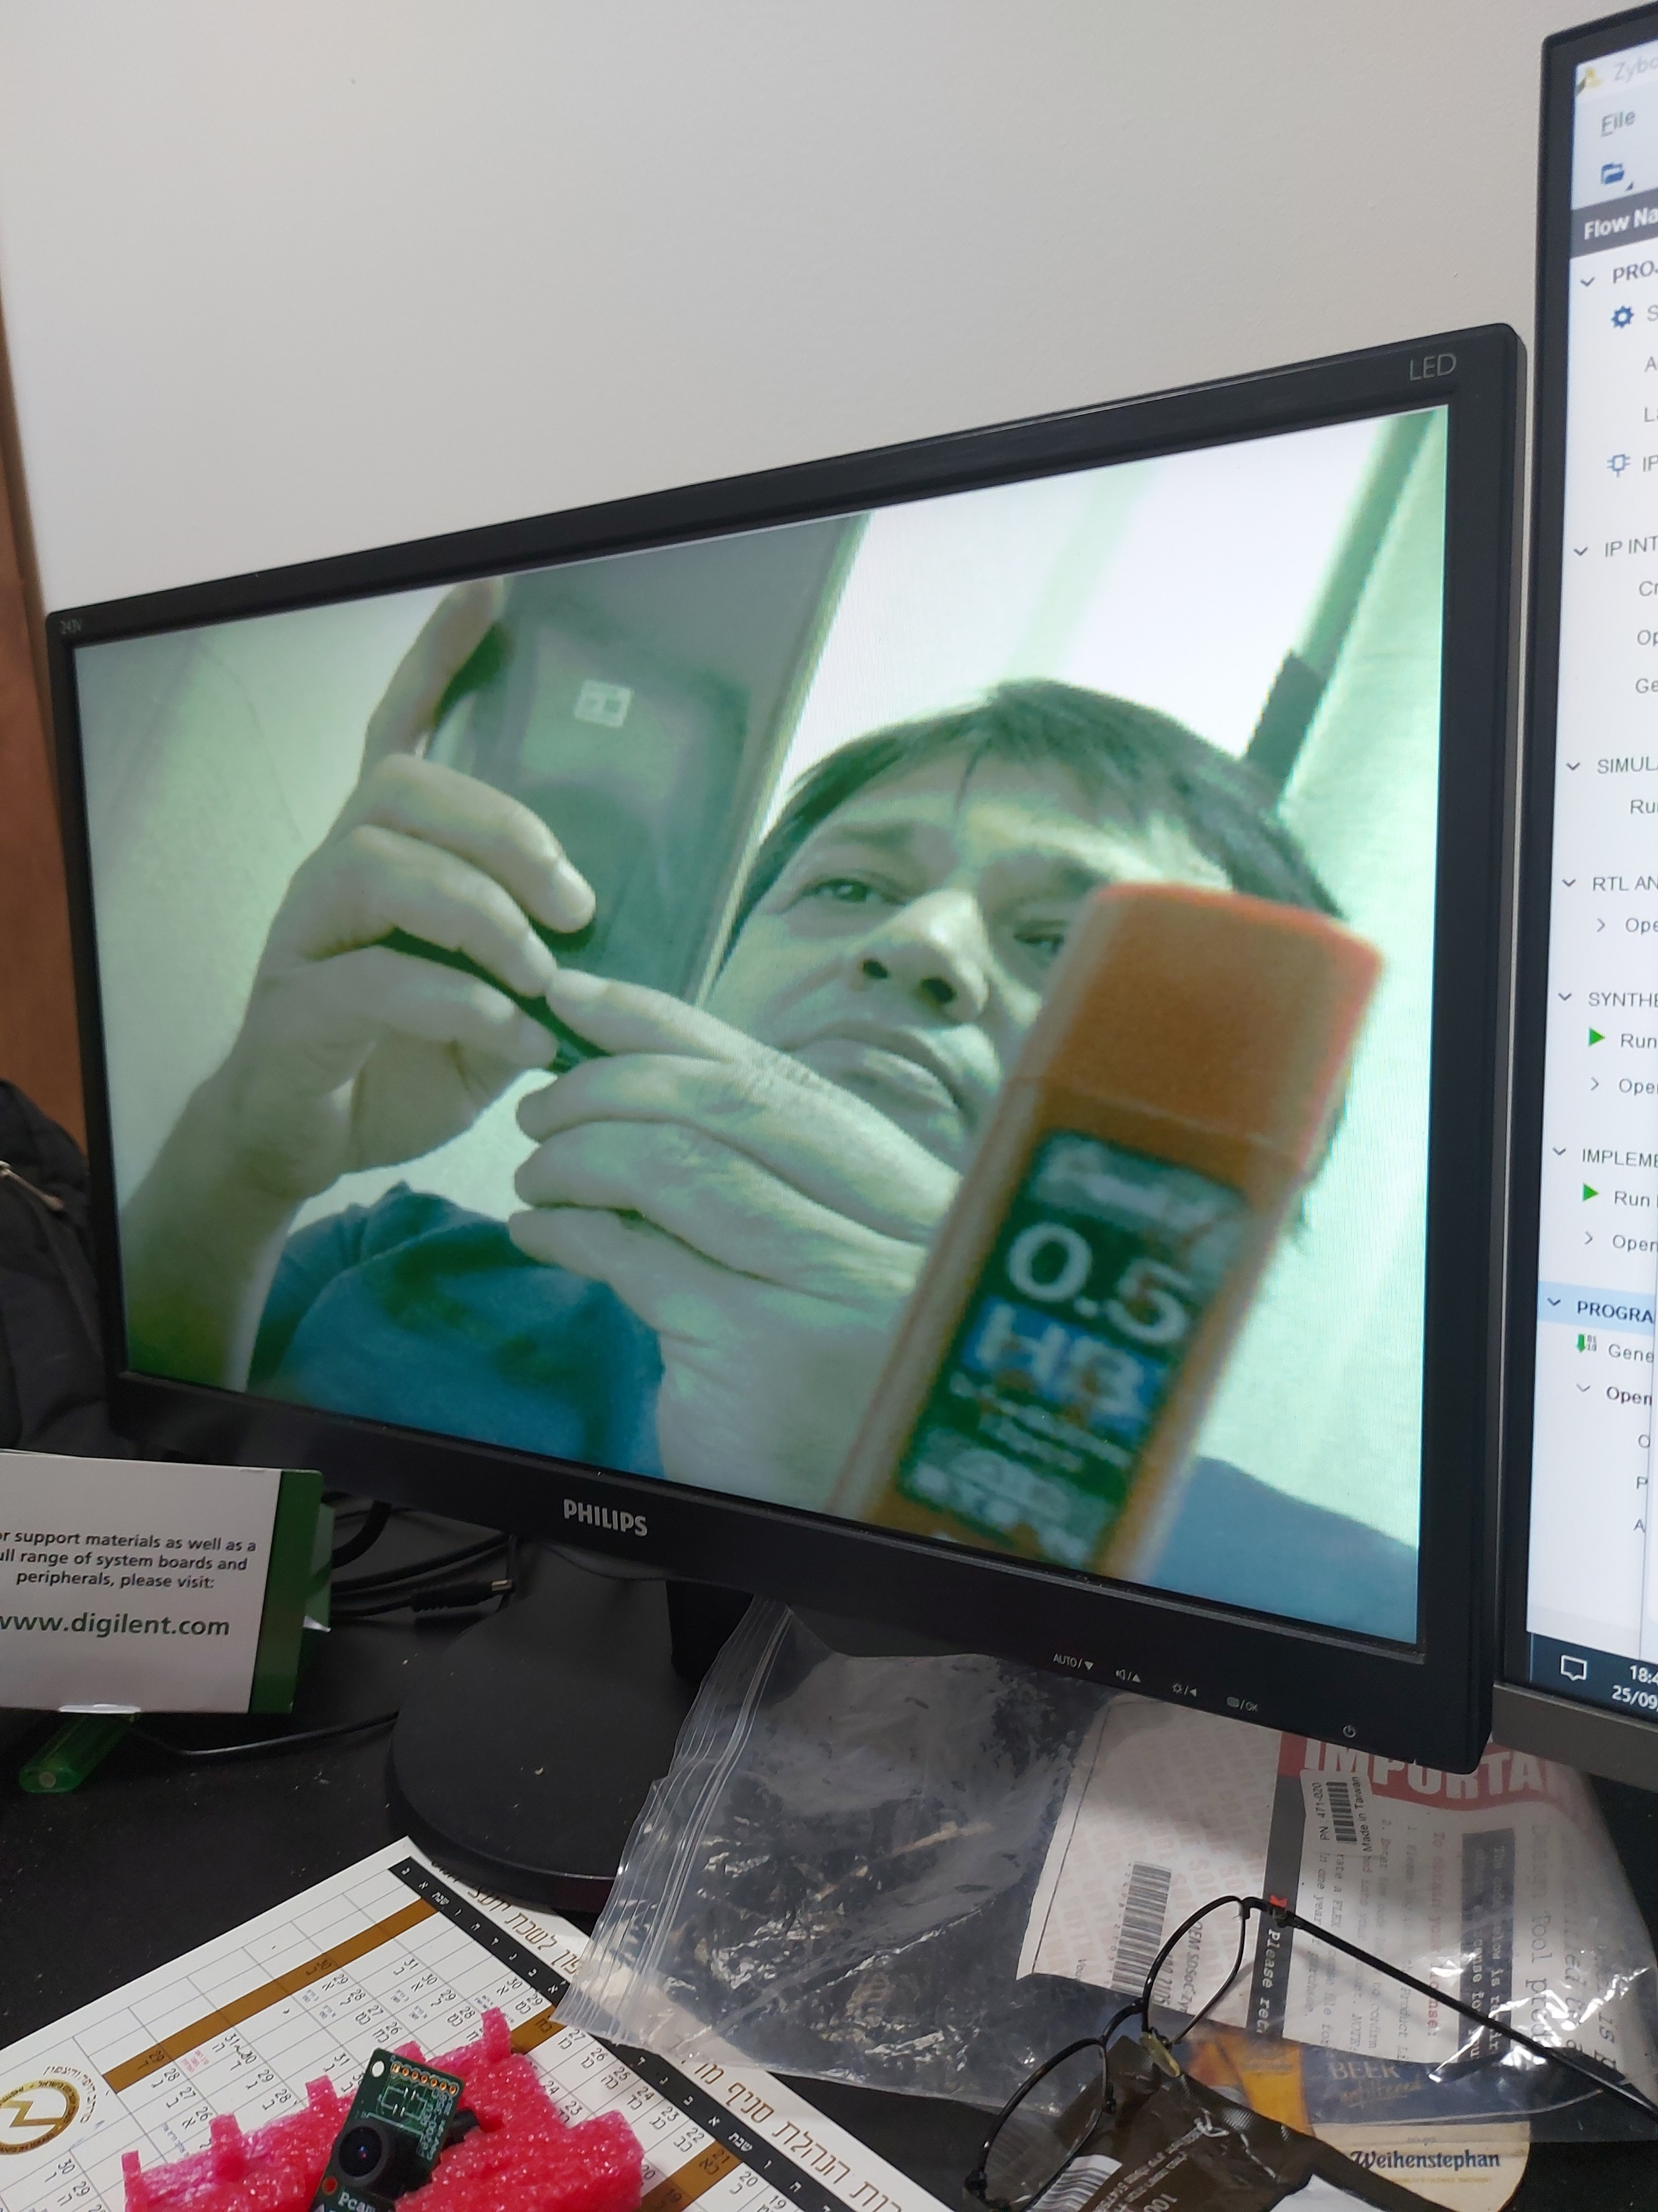
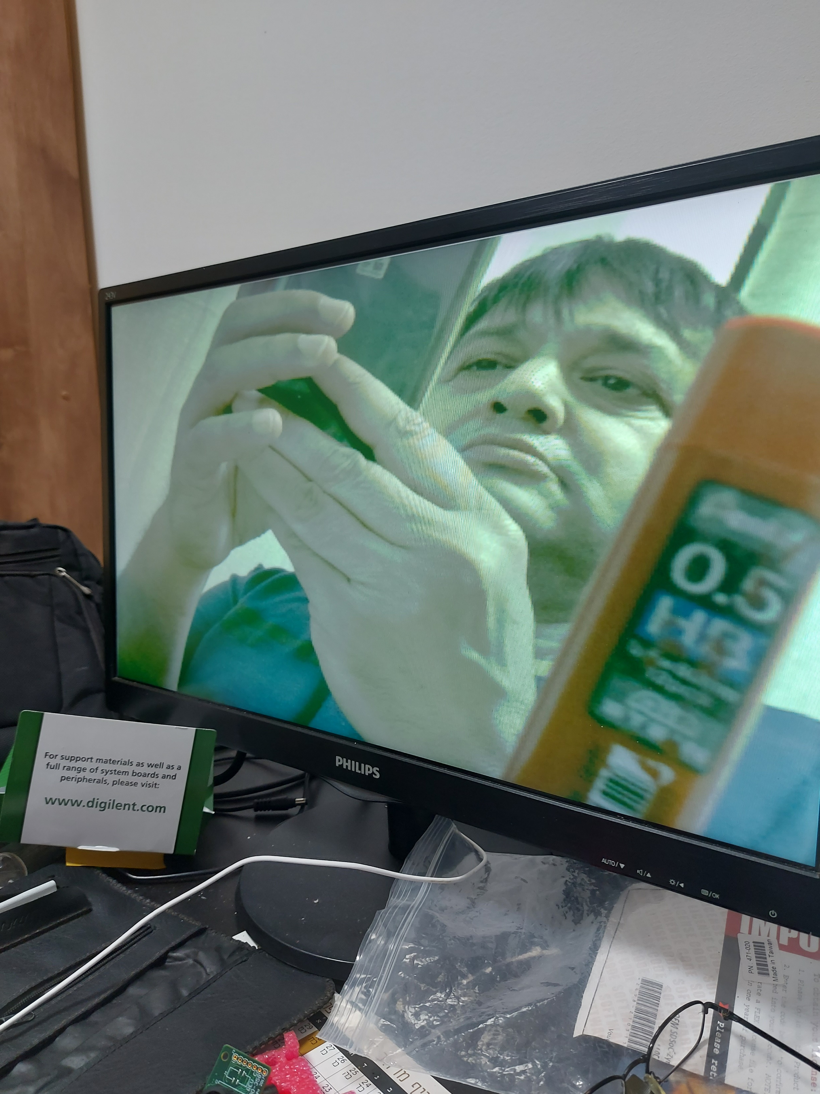

Slide 6
Original
1280x720;30fps
Original
640x480;60fps

Slide 7
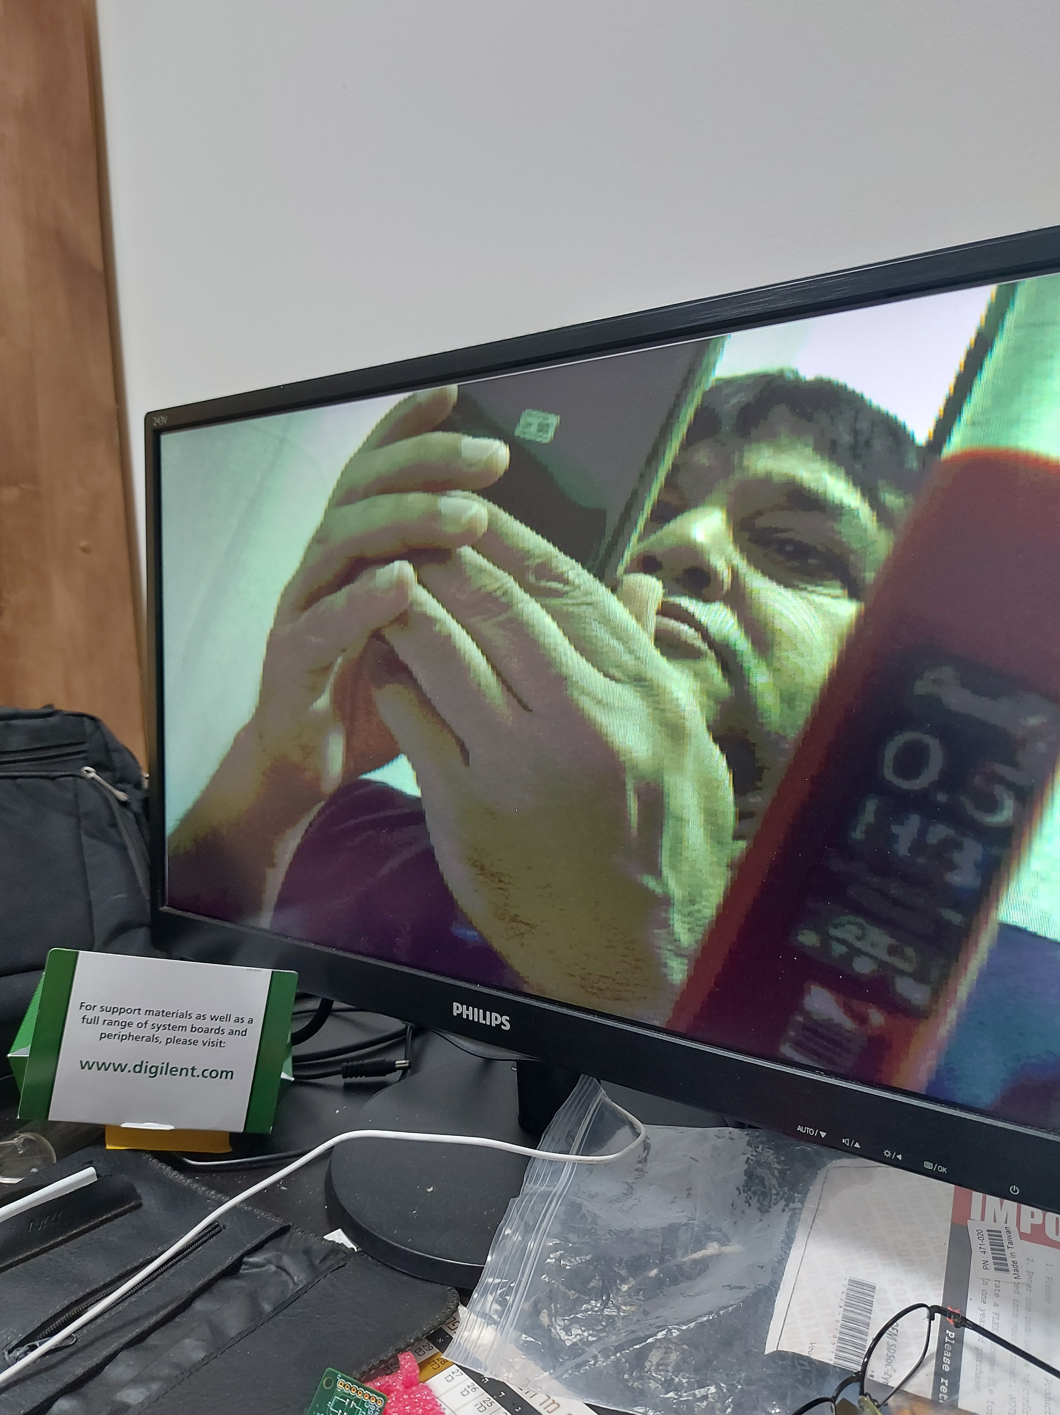
RGB444
640x480;60fps
Original
640x480;60fps

Slide 8
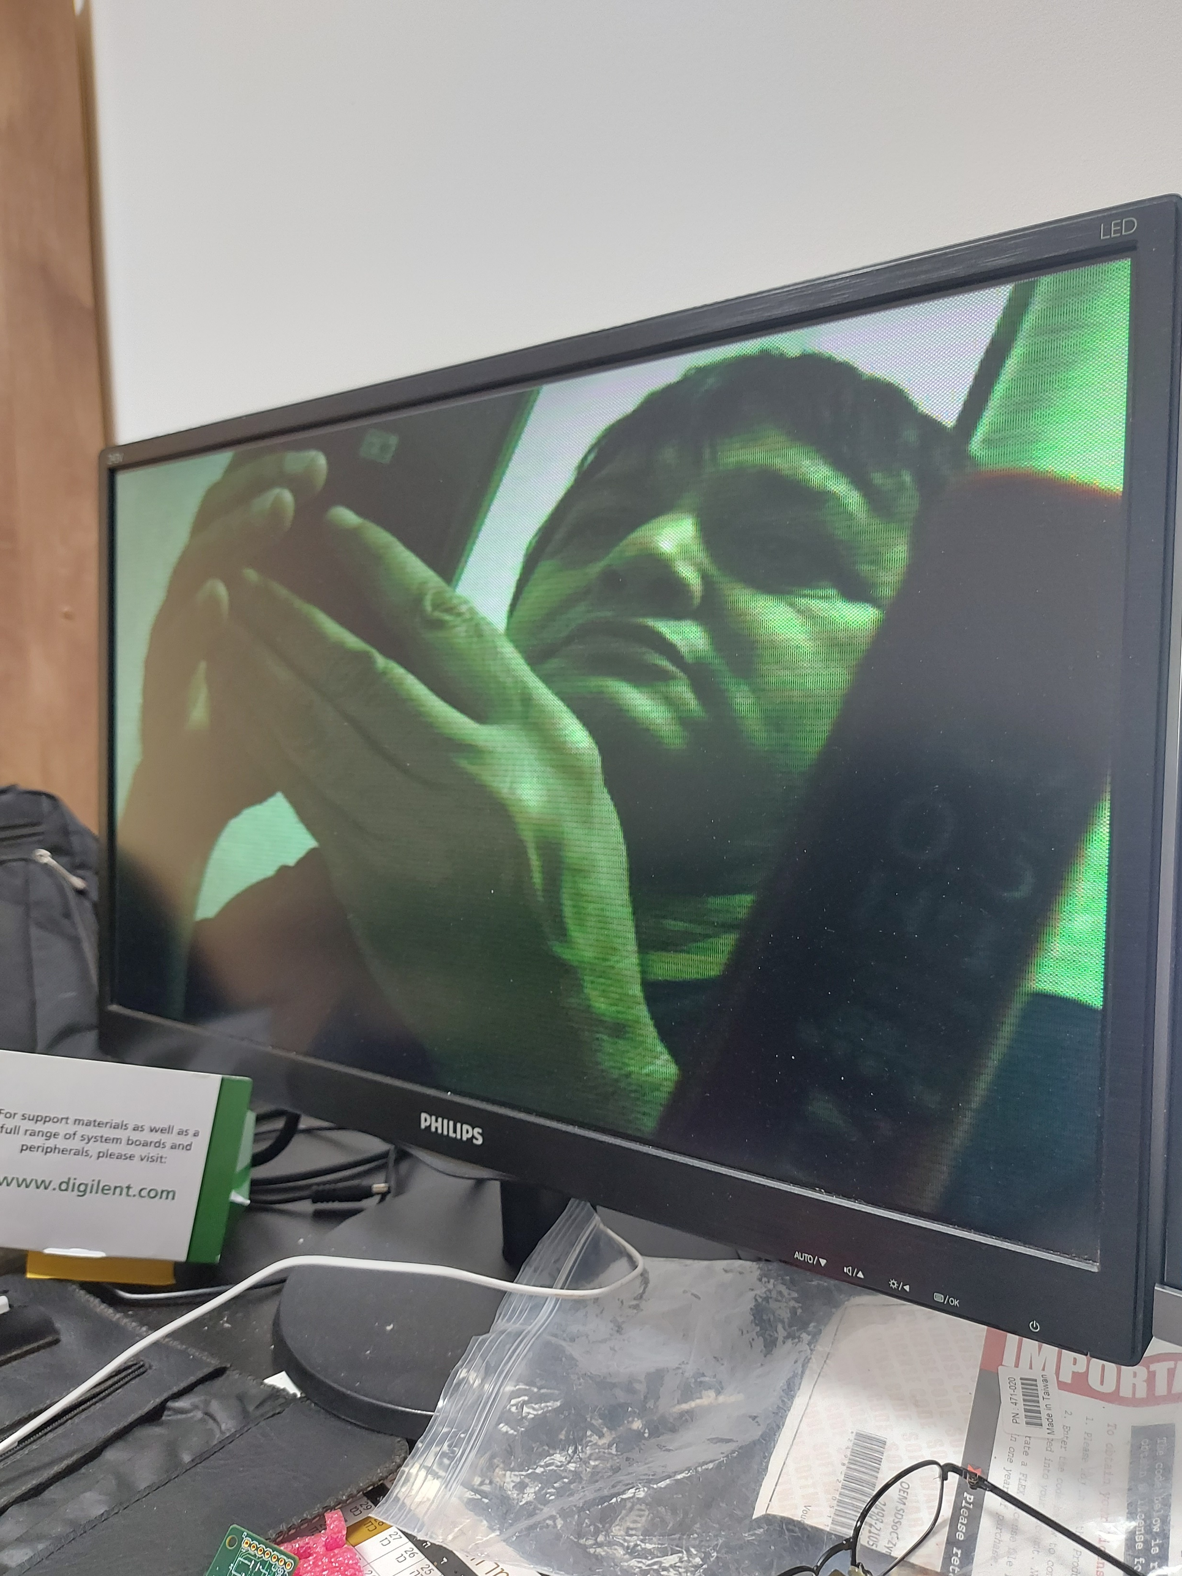
YCbCr5554:2:2
checkmath
640x480;60fps
Original
640x480;60fps

Slide 9
YCbCr5554:2:2
checkmath
640x480;60fps
RGB444
640x480;60fps

Slide 10
Original
1280x720;30fps
Original
640x480;60fps

Slide 11
RGB444
640x480;60fps
Original
640x480;60fps

Slide 12
YCbCr5554:2:2
checkmath
640x480;60fps
Original
640x480;60fps

Slide 13
YCbCr5554:2:2
checkmath
640x480;60fps
RGB444
640x480;60fps

